Slide 1

Real Time Project Seminar on
STOCK MARKET PREDICTION AND ANALYSIS USING DATA MINING
BY
B.TECH(CSE-AI&ML) II Year - II Semester
M. SREE SAMHITHA (22UP1A6648)
N.MADHURI (22UP1A6651)
S.ROOPA CHANDANA(22UP1A6659)
K.KEERTHANA (23UP5A6602)
INTERNAL GUIDE HEAD OF THE DEPARTMENT
Mrs .M.TEJOVATHI, Mr S.RANGASWAMY,
(Assistant Professor) ( Assistant Professor)
Department of CSE(AI&ML) ,VMTW Department of CSE(AI&ML)

Slide 2
CONTENTS
Introduction
Abstract
Existing System
Proposed System
Hardware and Software Requirements
System Architecture
Modules
Results
Conclusion

Slide 3
INTRODUCTION
Guides investment decisions by forecasting market trends, Manages investment risks through predictive analysis.
Tackles the complexity and volatility of financial markets, Identifies hidden patterns in historical data for predictive insights.
Uses techniques such as technical analysis, fundamental analysis, time series prediction, and machine learning.
Analyzes the impact of real-time news on stock prices through text mining.
Develops a model that predicts stock trends using both quantitative data and news articles.
Measures the effect of global events on stock markets.
Enhances prediction accuracy by integrating multiple data sources and techniques.
Aims to improve investment strategies with advanced data analysis and machine learning.

Slide 4
ABSTRACT
Historic data holds essential memory for predicting future market trends.
Data mining helps investors discover hidden patterns in historical data.
Stock market prediction is a challenging task in financial time series prediction.
Data analysis can predict if future stock prices will increase or decrease.
Examines the impact of various global events on stock markets.
Stock market prediction can be viewed as a specific data mining problem.
Text mining measures the effect of real-time news on stock prices.
Uses different techniques and strategies to predict market fluctuations.
Presents a model that predicts stock trend changes by analyzing news articles.
News articles are rich in information and often superior to numeric data for prediction.

Slide 5
EXISTING SYSTEM
Rapid digital data acquisition has led to massive data volumes in databases and repositories.
Extracting valuable information from this vast amount of data is challenging for humans without powerful tools.
Latest developments in Natural Language Processing (NLP) enable the extraction of meaningful information from news articles.
Predicting market behavior is inherently difficult due to the unpredictable nature of the future.
Stock prices are subject to volatility and risk, making accurate predictions challenging.
Availability of news information in digital form has improved accessibility for financial analysts.
However, analysts still face challenges in stock trading, such as identifying profitable stocks to buy and sell.
Stock market prediction has limitations in its scope and accuracy, primarily due to market unpredictability.

Slide 6
DISADVANTAGES
Predicting market behavior is inherently difficult due to the unpredictable nature of the future.
Stock prices are subject to volatility and risk, making accurate predictions challenging.
Financial analysts face difficulties in stock trading, such as identifying profitable stocks to buy and sell.
Easy and quick availability of news information was not always possible, complicating timely decision-making.
Stock market prediction has limitations in its scope and accuracy, primarily due to market unpredictability.

Slide 7
PROPOSED SYSTEM
Focus on predicting stock values using machine learning algorithms like Random Forest and Support Vector Machines.
Proposed system: "Stock market prediction and analysis" using the Random Forest algorithm.
Methodology for NLP module to predict stock prices is very complex.
Propose prediction based on news articles using sentiment analysis.
Aim to create a prediction system for the Indian Stock market.
Gather news articles.
Perform sentiment analysis on news articles.
Determine the polarity of the text.
Make a prediction based on the current stock price and calculated polarity of the text.

Slide 8
ADVANTAGES
Stock market prediction aims to determine the future movement of stock values in a financial exchange.
Stocks can be a valuable part of an investment portfolio.
Successful prediction can maximize customer benefits.
Human intelligence is a crucial factor in decision-making for predicting stock prices.

Slide 9
HARDWARE REQUIREMENTS
Processor - Intel core i5
RAM - 4 GB (min)
Hard Disk - 1 TB

Slide 10
SOFTWARE REQUIREMENTS
Operating System - Windows 11
Coding Language - Java, HTML, JSP
Data Base - MySQL
Development Kit - JDK 1.6
Web Server - Tomcat 6.0

Slide 11
MODULES
Data owner module
End User module (Data Consumer )
Cloud Server module
TPA (Third party Arbitrator)

Slide 12
DATA OWNER MODULE
Upload data : The data with its chunks is uploaded in the cloud server.
View Review : It views all data, it has been uploaded to the particular cloud server
View Cloud Files : It views the cloud files, to check the details which has entered
Verify Files : It checks the files which has entered was correct or wrong
Delete Files : We can also delete unwanted files from data owner files

Slide 13
END USER MODULE ( DATA CONSUMER)
Request File : Here, we can request the files to view to the cloud server by end user
Download File : We can download all the files only when, the particular cloud server approves the file if it rejects the file we cannot download the files
Send Feedback : We can send the actual feedback based on cloud services to the cloud server as, the cloud server can have a look of all the end users feedback which has sent

Slide 14
CLOUD SERVER MODULE
View Cloud Server Files : It views all the files stored in particular cloud server
View Attacker : It views all the attackers in which previously attackers details will be displayed only in cloud server
View End Users : It views all the end users and their details like – name, email id, service level agreement, phone number and their photo in which particular cloud server that they have stored the details
View Data Owners : It views all the data that includes – name, email id, service level agreement and their photo which has been stored in one particular cloud server
View Request Files : We can view the requested files which has been requested by end user
View Feedback : We can view all the feedback which was sended by end user

Slide 15
THIRD PARTY AUDITOR(TPA) MODULE
View All Attackers : We can view all the attackers, like the number of attackers tries to withhold the server but, not the details of attackers which is kept private can only be accessed the details of attackers by cloud server only
View All Metadata : We can see all the existing data of attackers here by encrypting information in terms of MAC, Secret Key

Slide 16
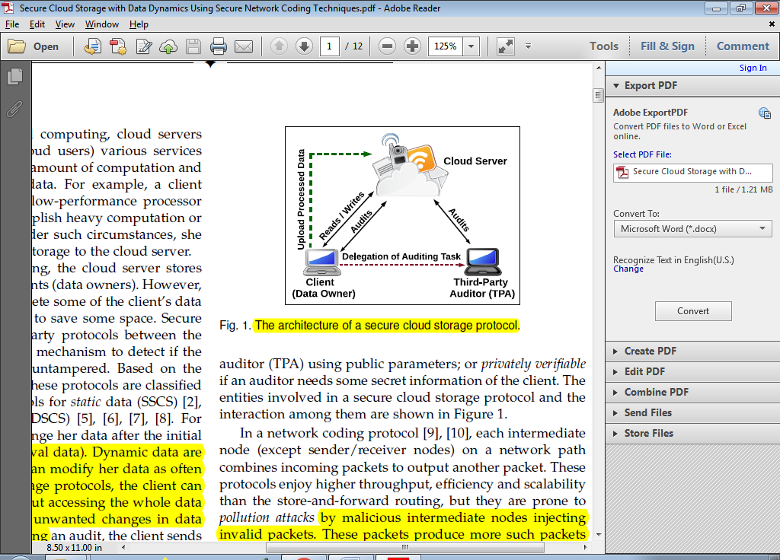
ARCHITECTURE
SYSTEM ARCHITECTURE OF CLOUD

Slide 17
USE CASE DIAGRAM
Login
Register
File Upload to Cloud
Admin
Search file
Download File
User Activation
Attackers
User
View User Request and Details

Slide 18
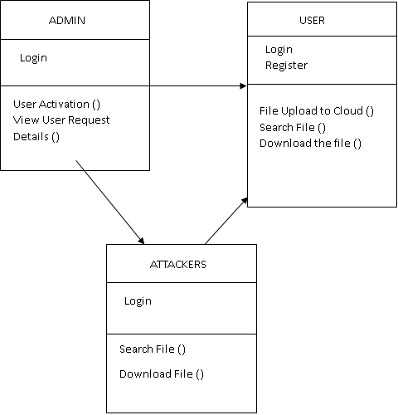
CLASS DIAGRAM

Slide 19
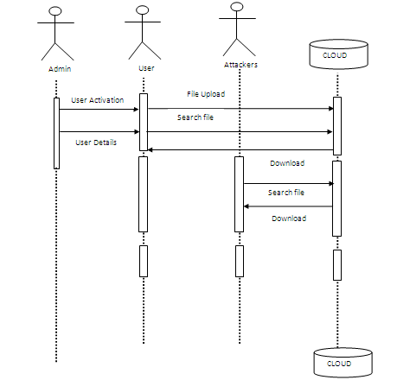
SEQUENCE DIAGRAM

Slide 20
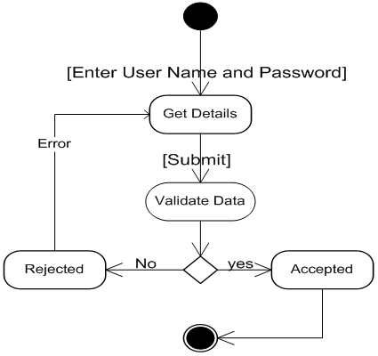
ACTIVITY DIAGRAM
NO
YES

Slide 21

RESULT
FIG 1. HOME PAGE

Slide 22

FIG 2. DATA OWNER LOGIN PAGE

Slide 23
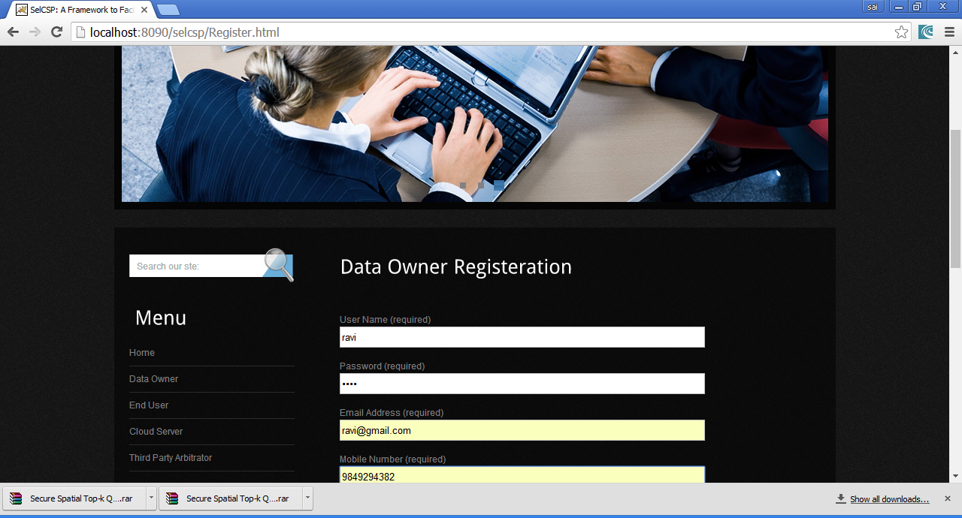
FIG 3. DATA OWNER REGISTRATION

Slide 24
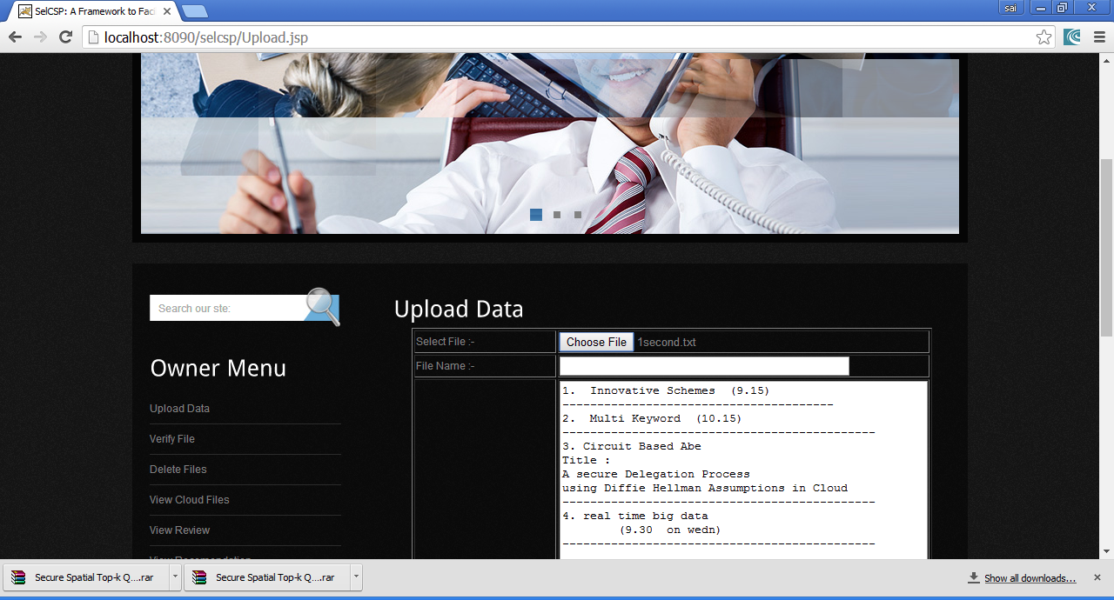
FIG 4. UPLOAD DATA

Slide 25
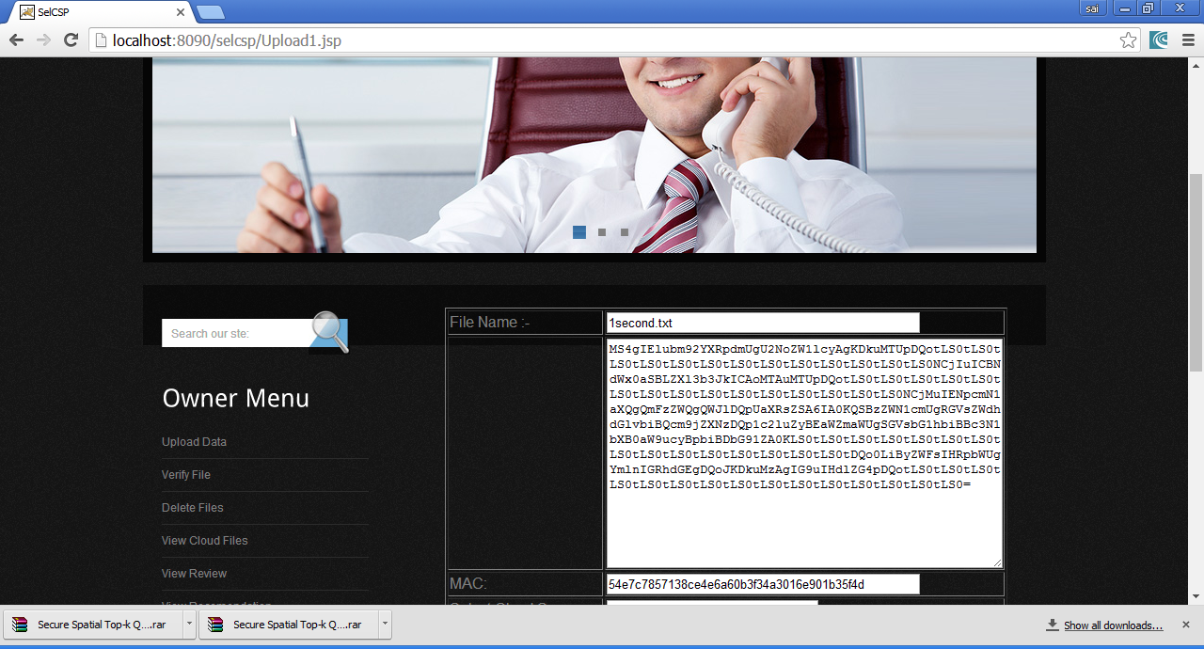
FIG 5. DATA OWNER MENU

Slide 26
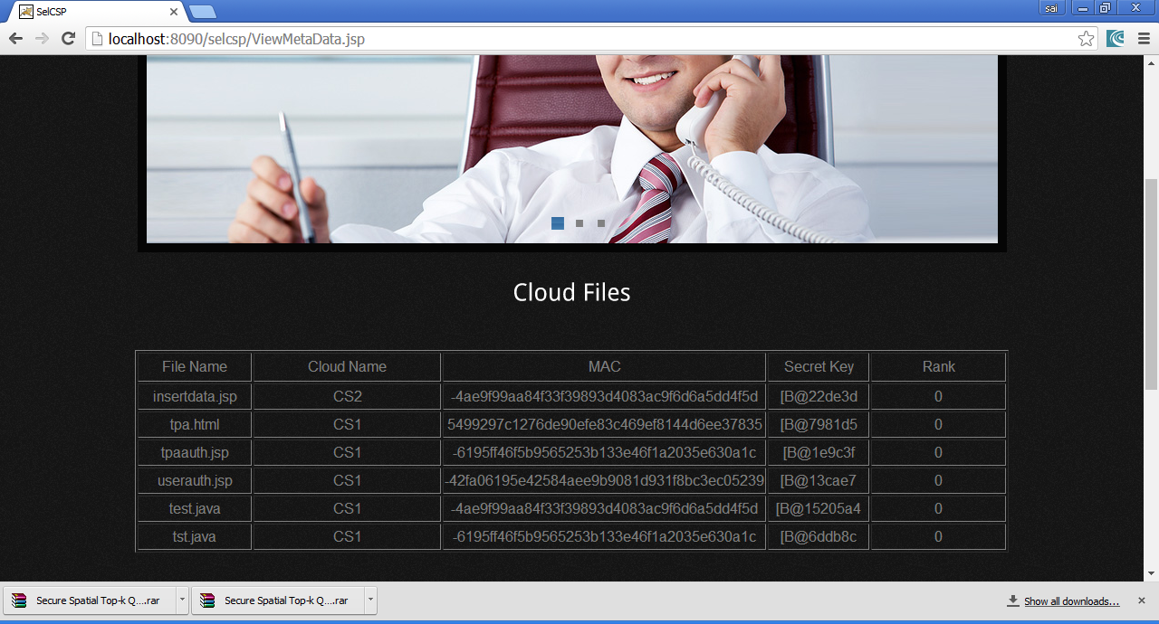
FIG 6. CLOUD FILES

Slide 27
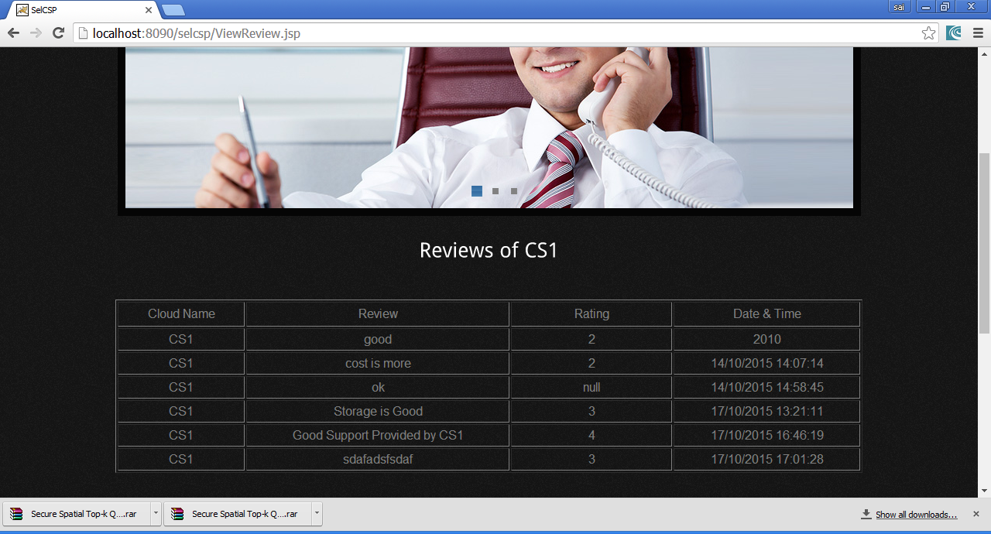
FIG 7 REVIEWS OF CS 1

Slide 28

FIG 8. END USER PAGE

Slide 29

FIG 9. CLOUD SERVER

Slide 30
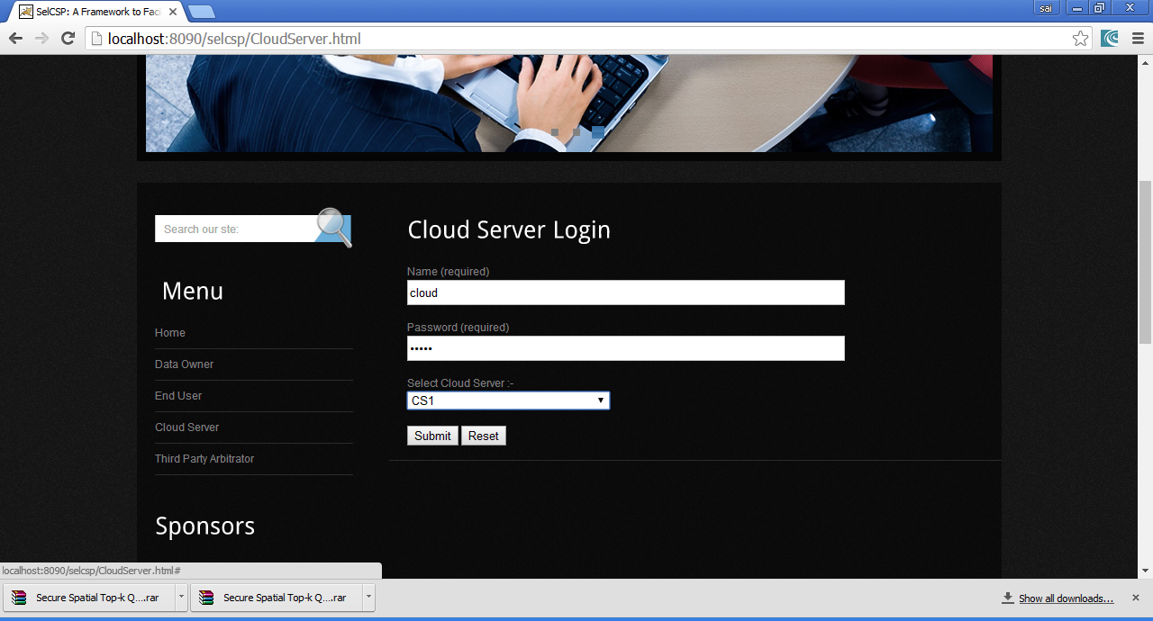
FIG 10. CLOUD SERVER LOGIN PAGE

Slide 31
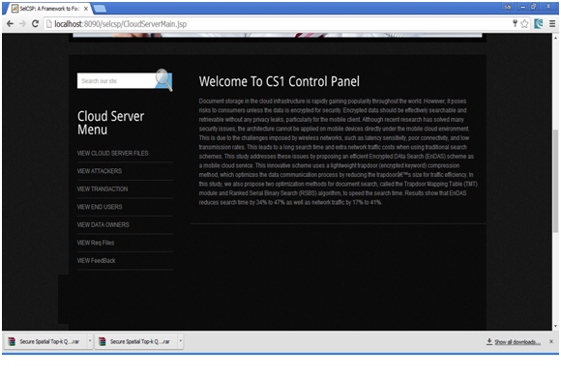
FIG 11. CLOUD SERVER MENU

Slide 32
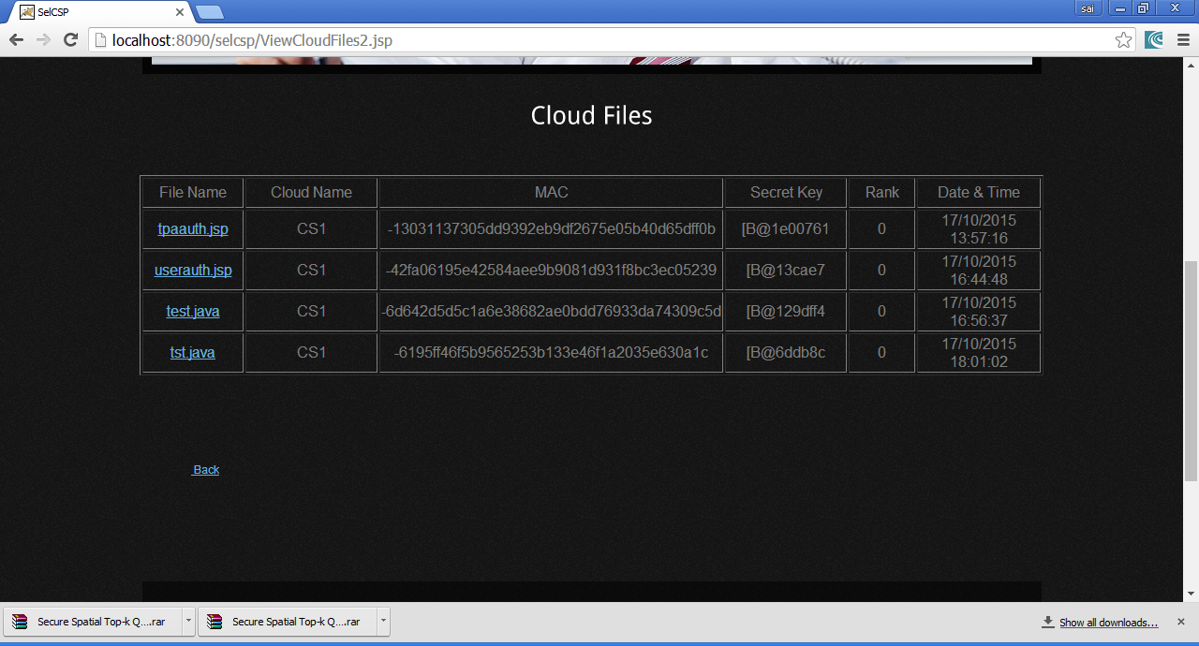
FIG 12 CLOUD SERVER FILES

Slide 33
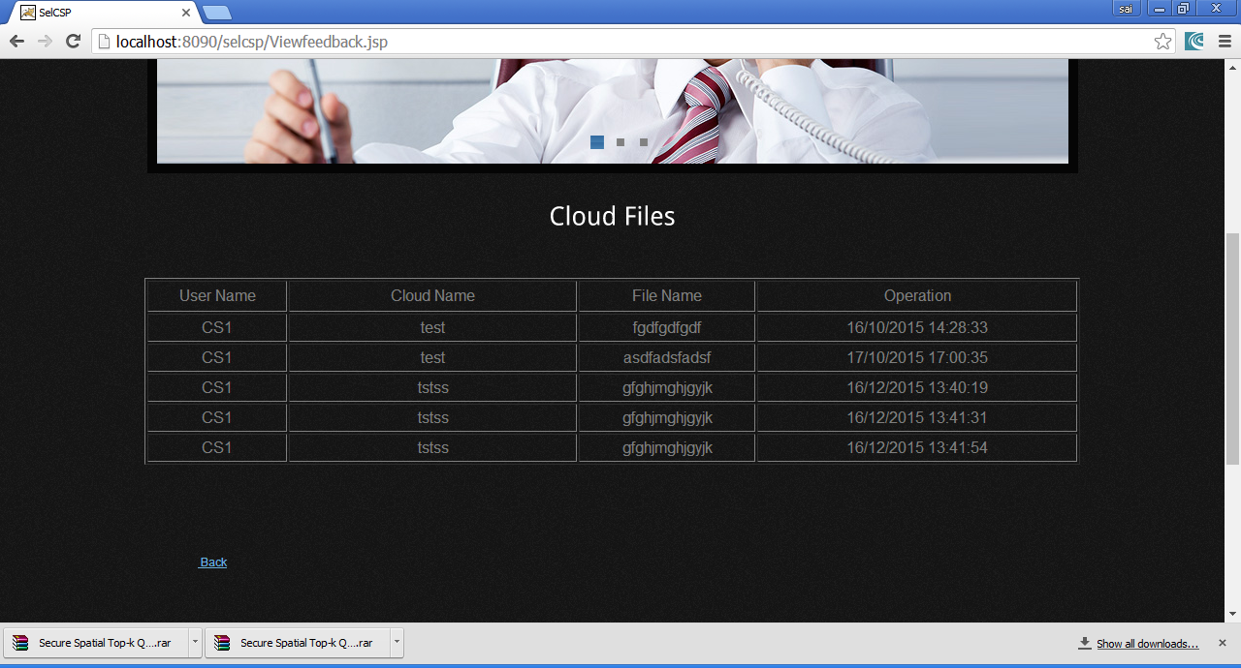
FIG 13. LIST OF CLOUD FILES

Slide 34
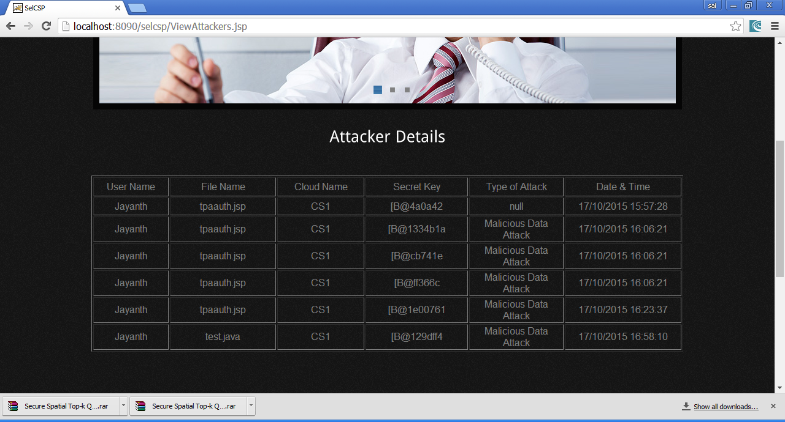
FIG 14. ATTACKER DETAILS

Slide 35
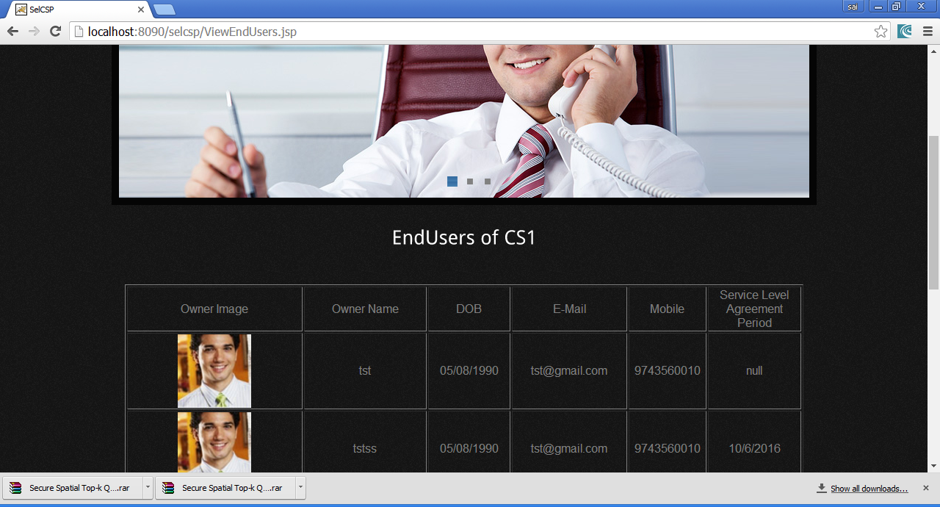
FIG 15. LIST OF END USERS

Slide 36

FIG 16. LIST OF DATA OWNERS

Slide 37
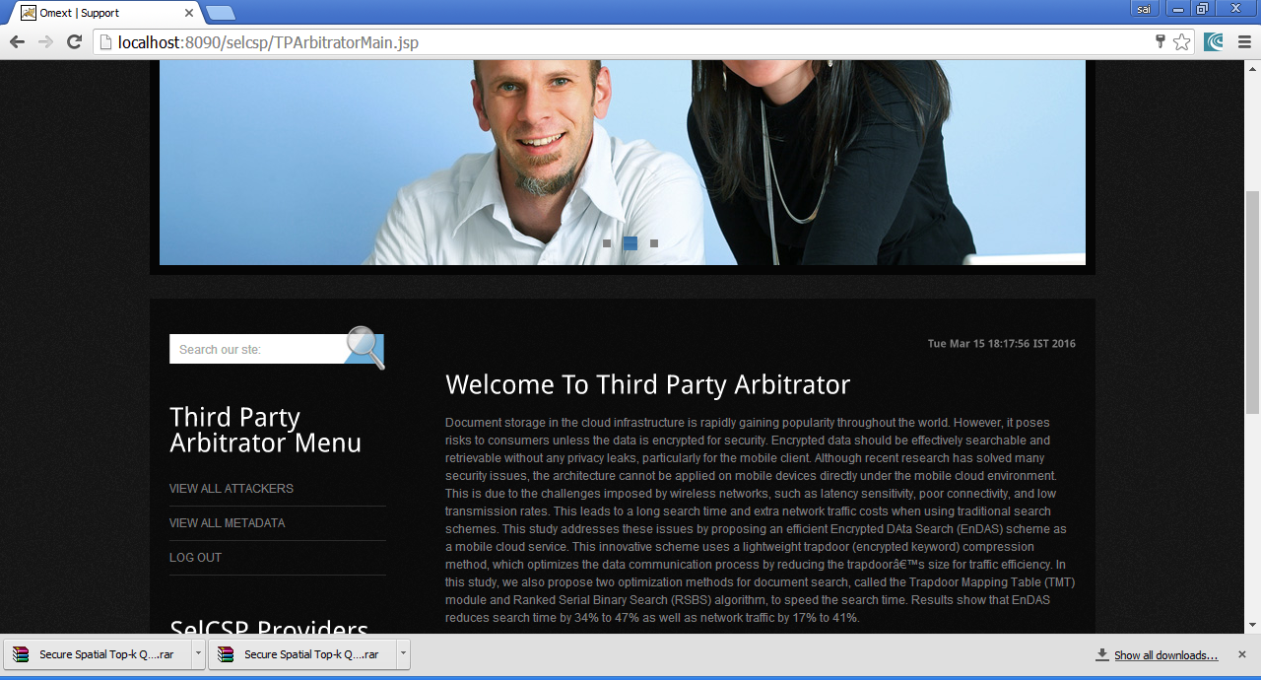
FIG 17. TPA MENU

Slide 38
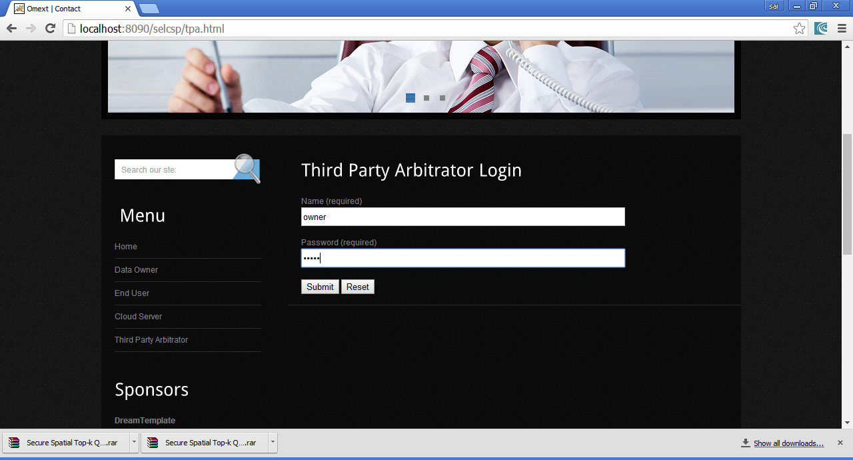
FIG 18. TPA LOGIN PAGE

Slide 39
FIG 19. LIST OF CLOUD FILES

Slide 40
CONCLUSION
In this project, we have proposed a secure cloud storage protocol for Dynamic Storage Cloud Security (DSCS I) based on a Secure Network Coding (SNC) protocol.
The first SNC-based DSCS protocol that is secure in the standard model and enjoys public verifiability.
A more efficient SNC protocol can give us a DSCS protocol with better efficiency.
We have also identified certain SNC protocols suitable for append-only data and constructed an efficient DSCS protocol (DSCS II) for append only data.
Finally, we have provided prototype implementations of DSCS I and DSCS II in order to show their practicality and compared the performance of DSCS I with that of an SNC-based secure cloud storage for static data.

Slide 41
REFERENCES
M. E. Porter, Competitive Strategy: Techniques for ,“Analyzing Industries and Competitors” Free Press, 1980.
B. H. Clark and D. B. Montgomery, “Managerial Identification of Competitors” Journal of Marketing, 1999.
W. T. Few, “Managerial competitor identification: Integrating the categorization, economic and organizational identity perspectives,” Doctoral Dissertaion, 2007.

Slide 42
LITERATURE SURVEY
S.No | Author name | Title of the paper | Name of the journal/Conference | Paper published year | Proposed Algorithm name/Methodology name | Merits | Demerits | Name of the parameters or Metrics or performance evaluated with their values
1. | Yanjie Song | Efficient and Secure Image Encryption Algorithm Using a Novel Key-Substitution Architecture | Institute of Electrical and Electronics Engineers | 2019 | Image Encryption Algorithm | Proposed substitution method which establish on s-boxes to different categories image encryption | Algorithm Have every complete Through Put process | Simulation,Speed Analysis
2. | Heba M. Khater | CryptograhicAccumulator-Based Schemefor CriticalData IntegrityVerificationin cloudstorage | Institute of Electrical and Electronics Engineers | 2019 | Cryptographic accumulator provable data possession (CAPDP | Verification process is self-reliant of the count of blocks being checked | Data owner must store Accumulator And tagre cord table | Robustness,Stateless Verification
3. | Wei Feng&Yigang He | A Plain-Image-Related Chaotic Image Encryption Algorithm Based on DNA Sequence Operation and Discrete Algorithm | International Journal of mechanical Engineering | 2019 | deoxyribonucleic acid (DNA) sequence operation and discrete logarithm | Makes Unwork able or intruder to deploy of Special plain-imageattack. | Algorithm Have low encryption efficiency | Improved Effciency

Slide 43
4. | Lokesh Kumar& Sushil Kumar Sharma | Fast Phrased Search for Encrypted Cloud Storage | SpringerLink | 2023 | AES Algorithm | Algorithm ismodified toenhancetopmostspeed ortopmostspeedalongaadoptablerepositorycost | Phrase searchbasedencryption forcloud storage isnotexploredate | Fast Retrieval,better security
5. | Poornima S,&Nivetha M | Authentication by Encrypted Negative Password | International Journal of mechanical Engineering | 2020 | Encrypted Negative Password using a symmetric-key algorithm | Technique is secure from look up table attack as dictionary | Hashingtechnique isusedbutstillhave improvethe passwordsecurity | Easy to integrate,Convenient to use
6. | James Hoew,Ayesha Khalid | PracticalDiscreteGaussianSamplers forLattice-BasedCryptography | Institute of Electrical and Electronics Engineers | 2016 | LatticeBased Cryptograph | Have strong enforcement to conform secure communication especially when the message is encoding in elliptic curve | Algorithm Is focus mostly inside channel Time attacks | Provides versatility and efficiency
7. | Huidan Hu& Changlu Lin | secure databackupscheme usingmulti-factorauthentication | Journal of American Society for Information Science and technology | 2018 | Multi factor Authentication (MFA) | Smartdevices lostand damagethey use, thepassword andbiometric forrecoveryprocess | Purpose of deleting the key is duplicate by weak security backup | Data backup

Slide 44
8. | Kunpeng Bhai, Chuankun Wu | AES-Like Cipher and Its White-Box Implementation | Springer Link | 2016 | AES Algorithm | The S-boxesis used topreventingthe knownwhite-boxattacks | S-boxes is veryefficient inprotection ofdata but stillexecution islong | Copy protection and large in size
9. | Joseph K.Liu,Kiatai Liang | Two-FactorData SecurityProtectionMechanismfor CloudStorageSystem | Institute of Electrical and Electronics Engineers | 2015 | Conventional Open Key Encryption (PKE) | Encrypted Data transfer through the cloud from sender to receiver | Two-factor authentication Is not enough to secure data in current environment | Integrity checking, Data masking
10. | Kan Yang, Xiahua Jia | Security of anEfficientDynamicAuditingProtocol inCloudStorage | Institute of Electrical and Electronics Engineers | 2012 | NLTK | Auditor can Detected Arbitrarily modified Cloud Data In auditing process | Auditor is playing major role in this algorithm. There are more possibilities due to human errors | Uses Efficient protocol

Slide 45
THANK YOU

